Slide 1

Data Visualization of Historical Rainfall in India
by
Huda Belim | Vignesh Muthumani | Tarun Reddy

Slide 2
contents
1
Introduction
2
Data Understanding
3
Methodology
4
Insights – Python (Bokeh)
5
Insights – Tableau
6
Conclusion
7
References

Slide 3
introduction
Rainfall is very crucial for a country like India, where agriculture is its backbone, which determines the GDP of the country.
There has to be sufficient amount of rainfall for Agriculture production and to avoid the drought.
In this presentation, we take a look at the previous history of rainfall in our country by states from 1901-2016.
This could provide us some critical insights on which state is most affected, how much rainfall is required, which state has it in surplus, etc.

Slide 4
Data understanding
The dataset we are going to be working on for this project is “Actual rainfall in India from 1901 to 2016” obtained from the meteorological department of India through data.gov.in.
The dataset has about 4416 observations and 15 variables.
It possesses the information on the amount of rainfall (in mm) for each of the 36 states of India.
It provides the information for the period of 1901-2016 by each month.
It is to be noted that the monsoon season falls under the months of June to September, where the amount of rainfall in each state is far higher than the other months.

Slide 5
Methodology
For visualizing the data, we use the following the tools and techniques
Python - Bokeh: Bokeh is an interactive visualization library in Python that targets modern web browsers for presentation. Its goal is to provide elegant, concise construction of versatile graphics, and to extend this capability with high-performance interactivity over very large or streaming datasets. Easy to create interactive plots, dashboards, and data applications [2].
Tableau: From connection through collaboration, Tableau is the most powerful, secure, and flexible end-to-end UI-based analytics platform for data visualization. Designed for the individual, but scaled for the enterprise, Tableau is the only business intelligence platform that turns data into insights that drive action [3].

Slide 6
Reasons for using python (Bokeh)
Python Bokeh provides a powerful way of using JavaScript like visualization technique. It has many interactive features which have been used in this project such as drag, tap, reset, save, hover, drop down list for state, drop down for type of plot, box and mouse wheel zoom, etc.
One great feature is the ability to save the certain section of visualization, this could be very useful in particular cases.
It also has box zoom and mouse wheel feature used.
Tap feature is used to provide external link to other website on click of the plotting.
This library is perfect if one likes using high level programming languages for visualization. Other than python it is also present in R and JavaScript.

Slide 7
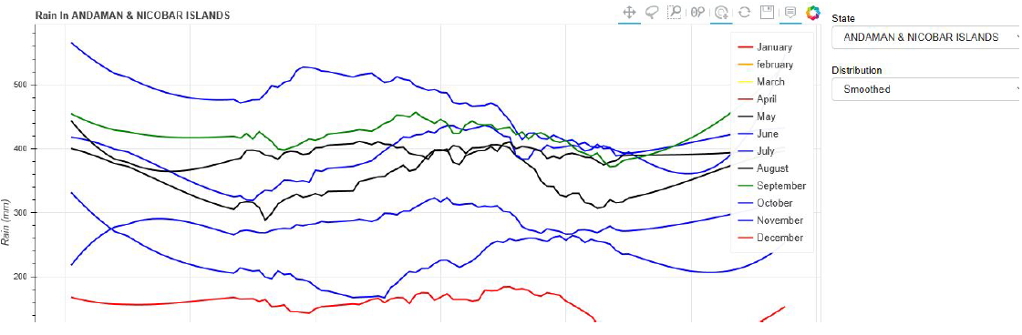
Insights – python (Bokeh)
1. Smooth viz for all the months in one state

Slide 8
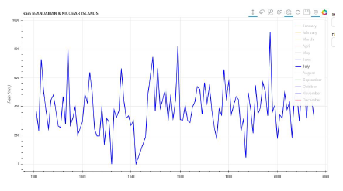
Insights – python (Bokeh)
2. Discrete viz for a particular month

Slide 9
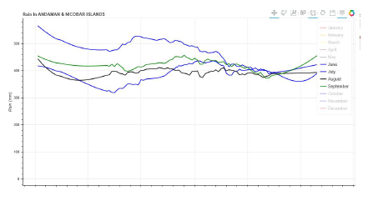
Insights – python (Bokeh)
3. Highest rainfall months

Slide 10
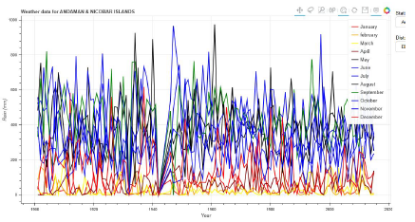
Insights – python (Bokeh)
4. All rainfall since 1901 to 2015 in discrete form.

Slide 11
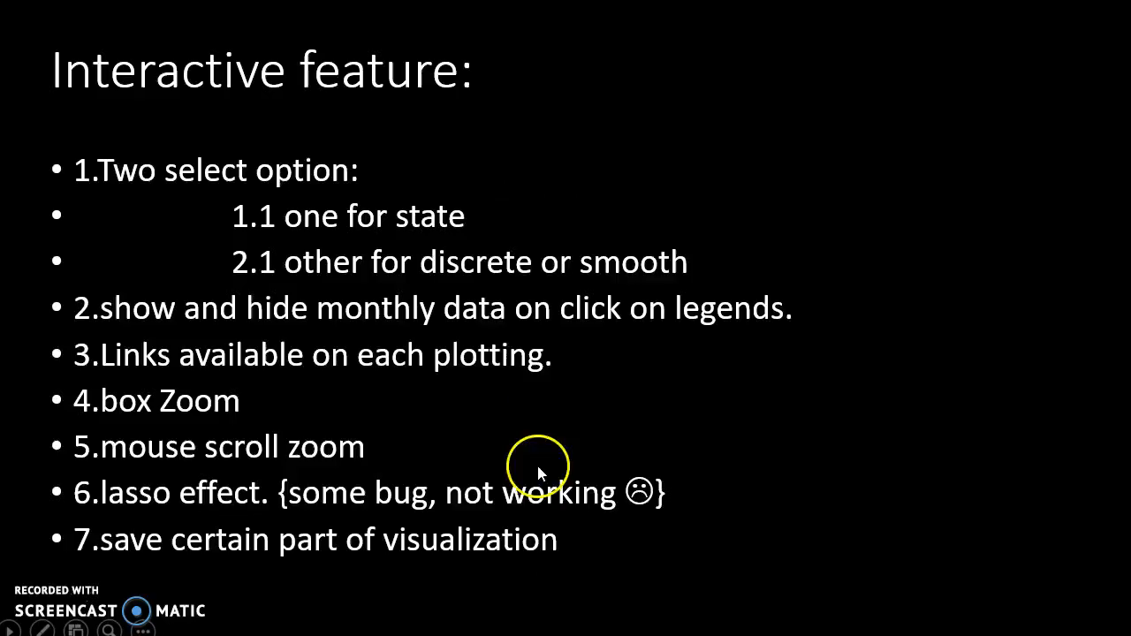

Slide 12
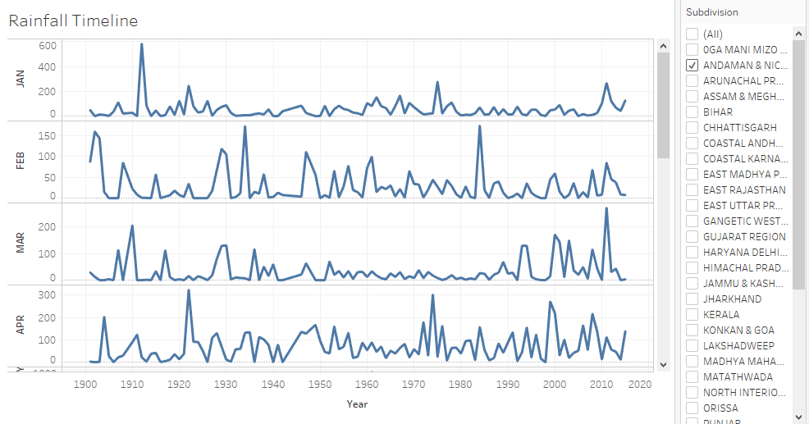
Insights – Tableau
Timeline of rainfall across all the years for each month by state

Slide 13
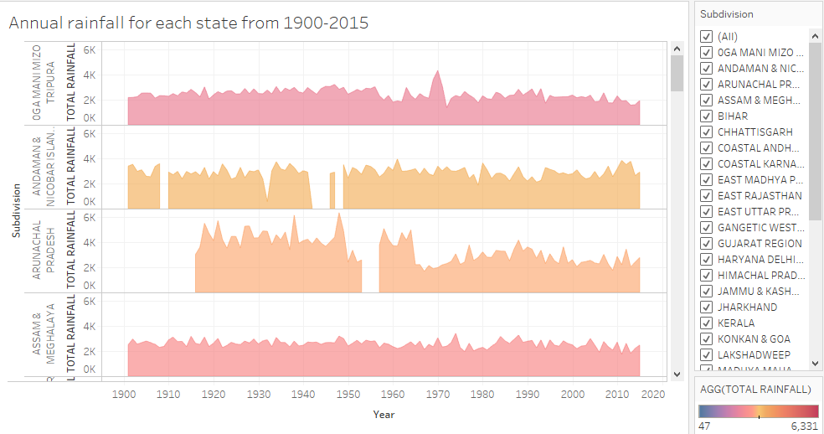
Insights – Tableau
Annual rainfall for each state from 1900-2016

Slide 14
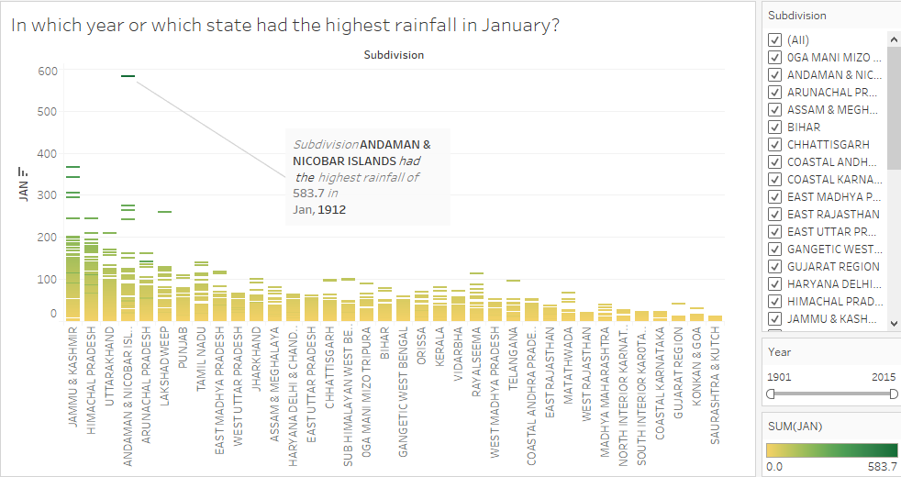
Insights – Tableau
In which year, which state had the highest rainfall

Slide 15
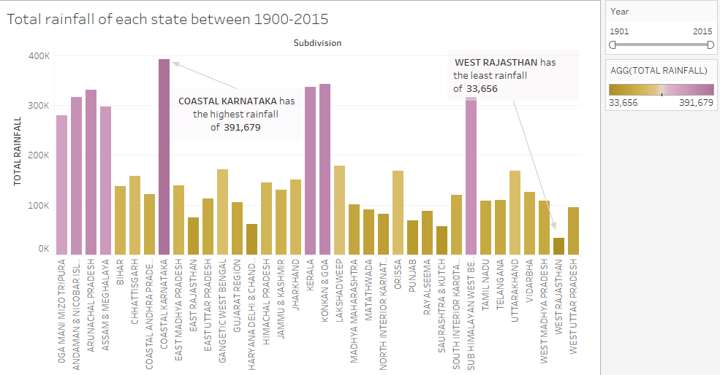
Insights – Tableau
Total rainfall of each state from 1900-2015

Slide 16
KEY insights
Monsoon Rainfall of 764.9 mm was observed during Jun-Sep of 2015. We had observed decline of -2.15% in rainfall during Jun-Sep of 2015 over the same period of 2014.
Monsoon Rainfall of 864.4 mm was observed during Jun-Sep of 2016. We had observed growth of 13.01% in rainfall during Jun-Sep of 2016 over the same period of previous year.
Monsoon (Jun-Sep) rainfall shows no noticeable trend from 1901 to 2016. During this period Maximum monsoon rainfall of 1124.2 mm was observed in the year 1917 and Minimum monsoon rainfall of 697.4 mm was observed in the year 1972.

Slide 17
key insights (cont’d)
Highest rainfall (583.7mm) is recorded in Andaman and Nicobar Islands in January 1912
Arunachal Pradesh has recorded the highest annual rainfall during the periods of 1945-50
Coastal Karnataka has recorded the maximum rainfall throughout the period of 1901-2015
West Rajasthan ranks at the bottom in almost all cases making it the driest state in India with the least amount of rainfall.

Slide 18
Conclusion
We were able to obtain some interesting insights from our rainfall data of India through data visualization with the help of tools like code-based Bokeh library and UI-based Tableau.
While this was data was chosen initially hoping to see a drastic or interesting trend of the rainfall pattern over 100 years, through our exploratory data analysis, we could see no such drastic change in the trend of rainfall. It has remained pretty constant throughout this period across all the regions with a constant mean and variance.

Slide 19
references
[1] Anon, (n.d.). Open Government Data (OGD) Platform India. [online] Available at: https://data.gov.in/
[2] Anon, (n.d.). Welcome to Bokeh â˘AˇT Bokeh 0.12.15 documentation. [online] Available at: https://bokeh.pydata.org/en/latest/
[3] Tableau [online] Available at: https://www.tableau.com/

